Slide 1
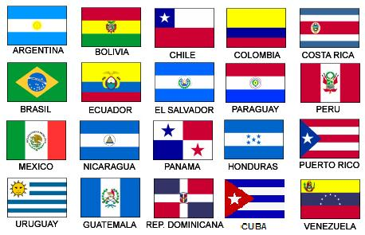
Español III con Senor Bly
rbly@hazelwoodschools.org
Voicemail 314.502.9209
¡Bienvenidos! Continuamos su educación española. ¡No tengan miedo!

Slide 2
Español III
A skill based class focusing on communication
After reviewing some Spanish I/II concepts, you will be introduced to these skills (for example, telling someone what to do) thru videos, vocab lists and verb charts posted on Google Classroom and live, active discussions
We will practice these skills during our class period thru partner activities, games, Quizlet.com, Kahoot, plus reading, listening and speaking activities.
You are expected to demonstrate these skills during discussions and interviews, Flip Grids, Google Slides, frequent formative assessments on Google Forms
Learning a language is a skill attainable by everyone. Look! You already know at least one!

Slide 3
Grading procedures
Classwork - 30%
Classwork, participation, homework, Do now, exit slips
Tests (assessments) - 70%
Speaking tests (interviews), Chapter tests, Projects
There are opportunities to improve test grades if you are not satisfied.

Slide 4
Google Classroom
Class Code:
This is our hub, where you will find most of our info, links to resources, schedules,, assignments, and assessments.
Daily, you will be asked to participate in some practice activities and discussion posts in the Stream.
You will find assignments, assessments and projects in the Classwork tab.

Slide 5
Rules and procedures
Please make sure you are making positive decisions that will help you be successful in class.
Be on time. Attempt each activity or assessment.
Attend class. Bring your materials to class.
Use our target language in class.
Be respectful of yourself, your classmates and staff members.
You will have 4 Hall passes per quarter. Any unused Hall passes will earn you 25 points extra credit EACH. Bathroom/locker/water passes are for a maximum of 5 minutes unless agreed upon by Profe Bly.

Slide 6
Rules and procedures
We will follow the school procedures for tardies, truancy, cell phone use and disruptive behavior. In short… First occurrence, you will be refocused by Profe Bly
Upon second correction, there will be communication with parent or guardian.
Further infractions, will result in communication with grade level office.
Communication with you and your family is important to me. I will share and celebrate your successes, but will also share if you are not attempting To Speak Spanish, not participating in class, or are letting your grade slip below a 70%.

Slide 7
Syllabus - Pacing Guide
Repaso 1 - El presente - Review 1 (8 weeks)
Students will be able to:
Greet and say goodbye to others, introduce themselves and others
Describe their classroom, friends, family and others
Discuss what activities they like and dislike
Describe their classes and teachers using the verbs tener and ser
Discuss clothing and colors with -AR verb conjugation

Slide 8
Syllabus - Pacing Guide
Repaso 1 - El presente - Review 2 (8 weeks)
Students will be able to:
Use the verb IR to discuss going to different locations and businesses around town
Use the verb estar to talk about where places and things are located (The park is next to the supermarket)
Use the verb estar to talk about how they feel
Review stem changing verbs with sports vocabulary

Slide 9
Objetivos - learning targets
Repaso 3 - el pasado (8 weeks)
Students will be able to:
Narrate and describe past events with the preterit tense and travel vocabulary
Discuss our daily routine using reflexive verbs

Slide 10
Objetivos - Learning targets
Capítulo 1 - Mi niñez - el imperfecto(3 weeks)
Students will be able to:
Use the imperfect tense to discuss their childhood (When I was younger I used to… )

Slide 11
Objetivos - Learning targets
Capítulo 2 - Mi futuro - el futuro(3 weeks)
Students will be able to:
Use the future tense to discuss their goals for the next 10 years
The remaining 2 weeks will be used to prepare for Final projects and Final exams.

